Slide 1

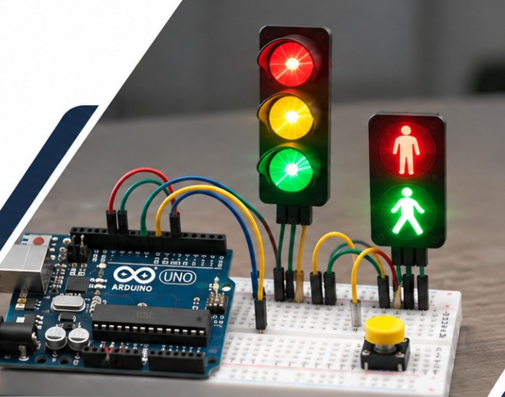
Arduino-Based Traffic Light Control System
EMBEDDED SYSTEMS · COURSE PROJECT
with Pedestrian Crossing
An automatic traffic light on the Arduino Uno. It grows from a basic four-state cycle into a six-state crossing with a pedestrian button and safety phases.
Arduino Uno
Embedded C/C++
State machines
UML
Tinkercad
GitHub
PROJECT TEAM · HOCHSCHULE HAMM-LIPPSTADT
Torikul Islam
Somya
Muhammad Waleed Mushtaq
Notes:
Welcome. This project builds an automatic traffic light on an Arduino Uno. Task 1 is the basic four-state light; Task 2 adds a pedestrian button and two safety phases. We modelled it with state machines and UML, simulated it in Tinkercad, programmed it in C/C++ and ran it on real hardware.

Slide 2
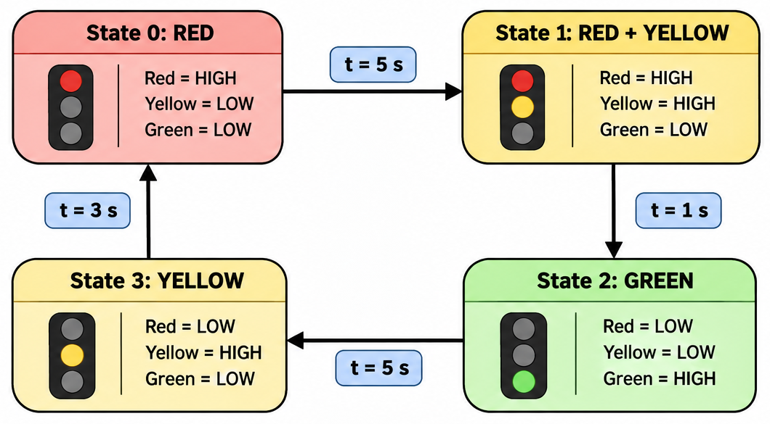
Four-State Traffic Light
02
TASK 1 · STATE MACHINE
State | Light | Duration
0 | Red | 5 s
1 | Red + Yellow | 1 s
2 | Green | 5 s
3 | Yellow | 3 s
Σ | Total cycle | 14 s
Key features
Four-state finite state machine
Automatic, timer-driven transitions
Predefined timing for every state
The sequence repeats continuously
RED → RED + YELLOW → GREEN → YELLOW → RED
Hochschule Hamm-Lippstadt · Embedded Systems
02 / 10
Notes:
Task 1 is a four-state machine. Red lasts 5 seconds, red plus yellow 1 second, green 5 seconds and yellow 3 seconds, so one full cycle takes 14 seconds. Each state switches automatically when its timer expires and the sequence repeats forever.

Slide 3
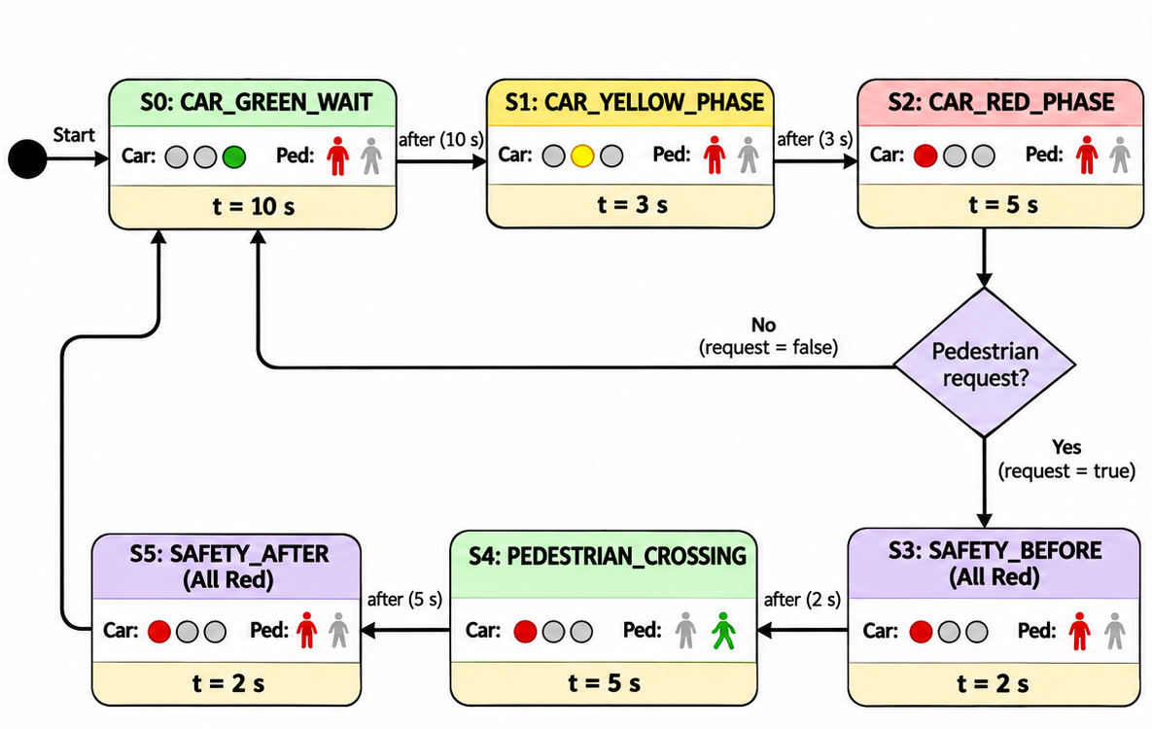
Pedestrian Crossing Logic
03
TASK 2 · PEDESTRIAN BUTTON
State | Phase | Duration
S0 | Car green | 10 s
S1 | Car yellow | 3 s
S2 | Car red | 5 s
S3 | Safety before | 2 s
S4 | Pedestrian crossing | 5 s
S5 | Safety after | 2 s
How a request works
A button press stores the request
After car red (S2) the request is checked
No request: back to S0. Request: S3, S4, S5
Car green and pedestrian green are never on together. Two all-red phases separate them.
S0–S2
Normal car cycle
S3 and S5
Safety, all red
S4
Pedestrian green
Hochschule Hamm-Lippstadt · Embedded Systems
03 / 10
Notes:
Task 2 extends the controller to six states: CAR_GREEN_WAIT, CAR_YELLOW_PHASE, CAR_RED_PHASE, SAFETY_BEFORE, PEDESTRIAN_CROSSING, SAFETY_AFTER. Car green lasts 10 s, yellow 3 s and red 5 s. A button press sets a stored request. After car red the controller checks it: without a request it returns to green, with a request it runs 2 s all-red, 5 s pedestrian green and 2 s all-red. Because both safety phases keep every light red, car green and pedestrian green can never overlap.

Slide 4
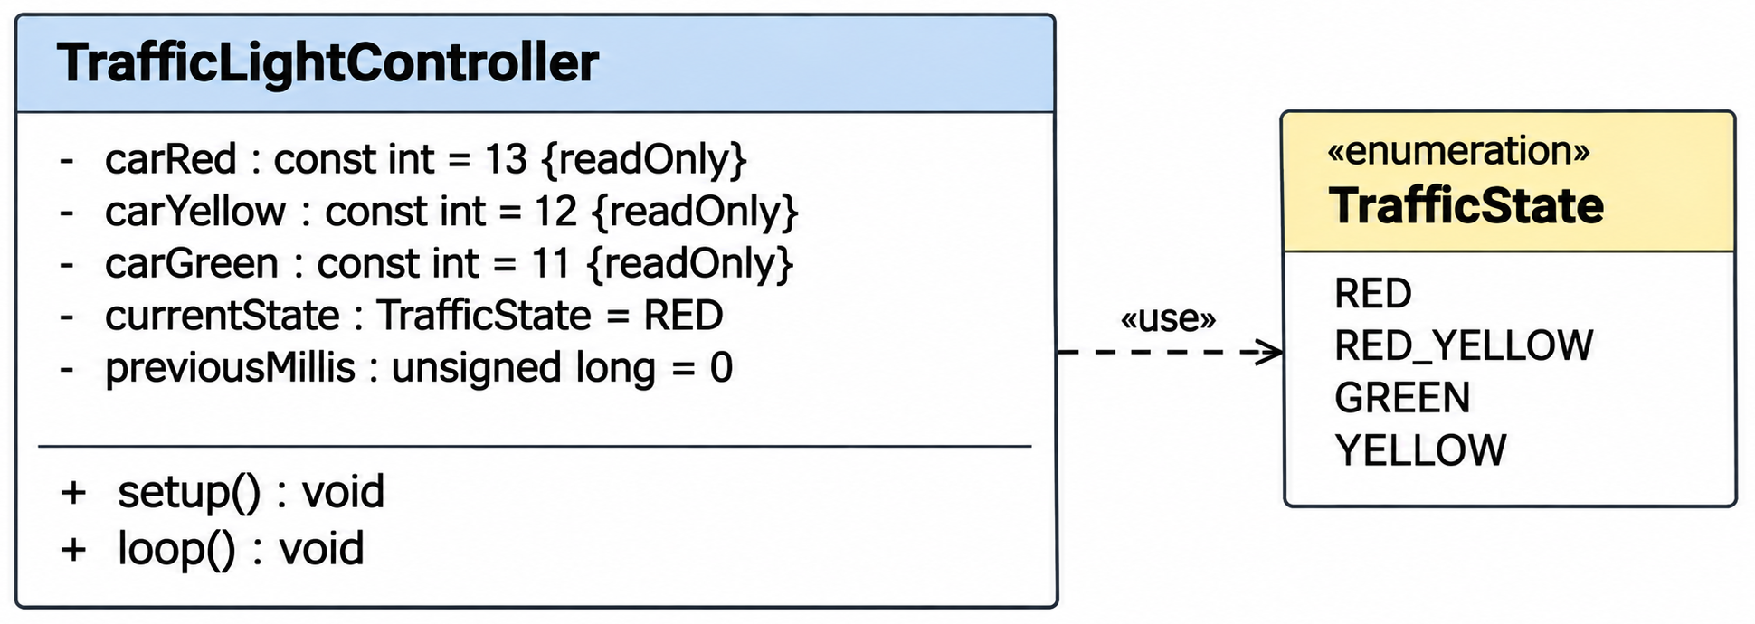
Class Diagram
04
TASK 1 · UML MODELING
Output pins
13
12
11
Red LED
carRed
Yellow LED
carYellow
Green LED
carGreen
All three pins are set as outputs in setup().
State variables
Functions
TrafficState enum
currentState holds the active light state and starts at RED.
setup() configures the three LED pins as outputs.
RED
RED_YELLOW
GREEN
YELLOW
previousMillis stores the time of the last transition for millis() timing.
loop() checks the elapsed time and switches to the next state.
One value for each of the four light states.
Hochschule Hamm-Lippstadt · Embedded Systems
04 / 10
Notes:
The class diagram shows TrafficLightController. Its three private constants map the LEDs to pins 13 (red), 12 (yellow) and 11 (green). currentState holds the active state from the TrafficState enumeration and previousMillis stores when the last transition happened. setup() configures the pins as outputs and loop() checks the elapsed time and moves to the next state.

Slide 5
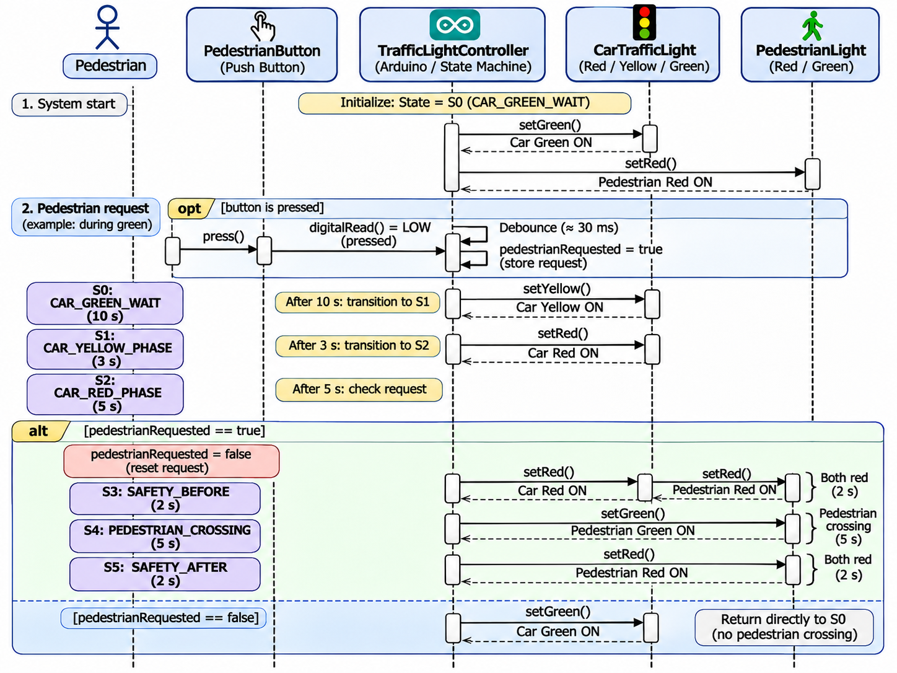
Sequence Diagram
05
TASK 2 · UML MODELING
Button detection
digitalRead() polls pin 2 in every loop. A 30 ms software debounce filters unstable signals.
Request storage
A confirmed press sets pedestrianRequested to true. It is kept until the car red phase ends.
Normal cycle
Green, yellow, red, then the request is checked. No request: straight back to green.
Crossing with two safety phases
S3 all red 2 s, S4 pedestrian green 5 s, S5 all red 2 s.
Hochschule Hamm-Lippstadt · Embedded Systems
05 / 10
Notes:
Walk through the diagram top to bottom. The system starts in S0 with car green and pedestrian red. When the pedestrian presses the button during green, the controller reads pin 2 with digitalRead, debounces for about 30 ms and stores pedestrianRequested = true. The car phases then run S0 to S2. After car red the controller checks the request: if true it runs S3 all red, S4 pedestrian green and S5 all red before returning to green; if false it returns to green directly.

Slide 6
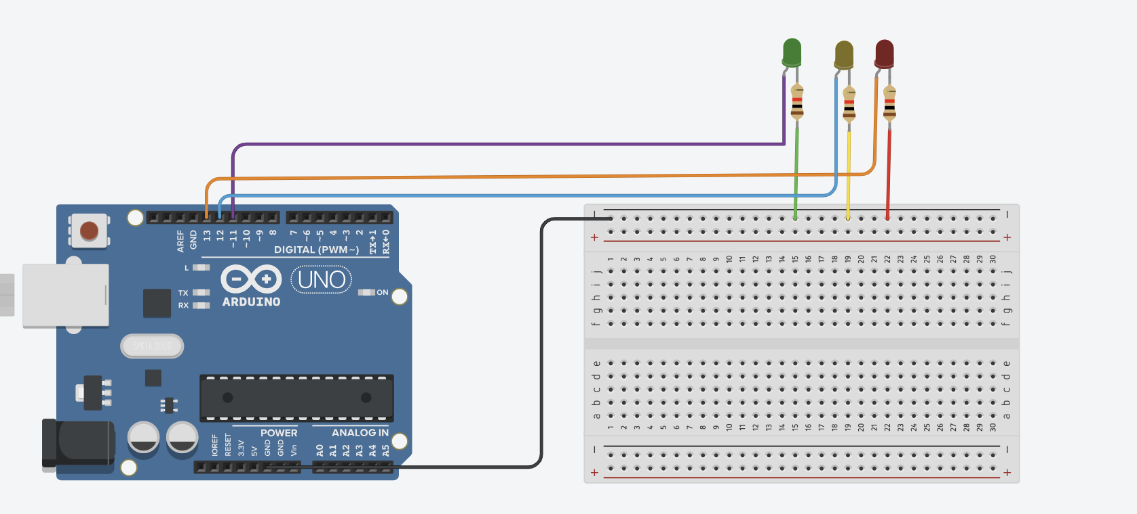
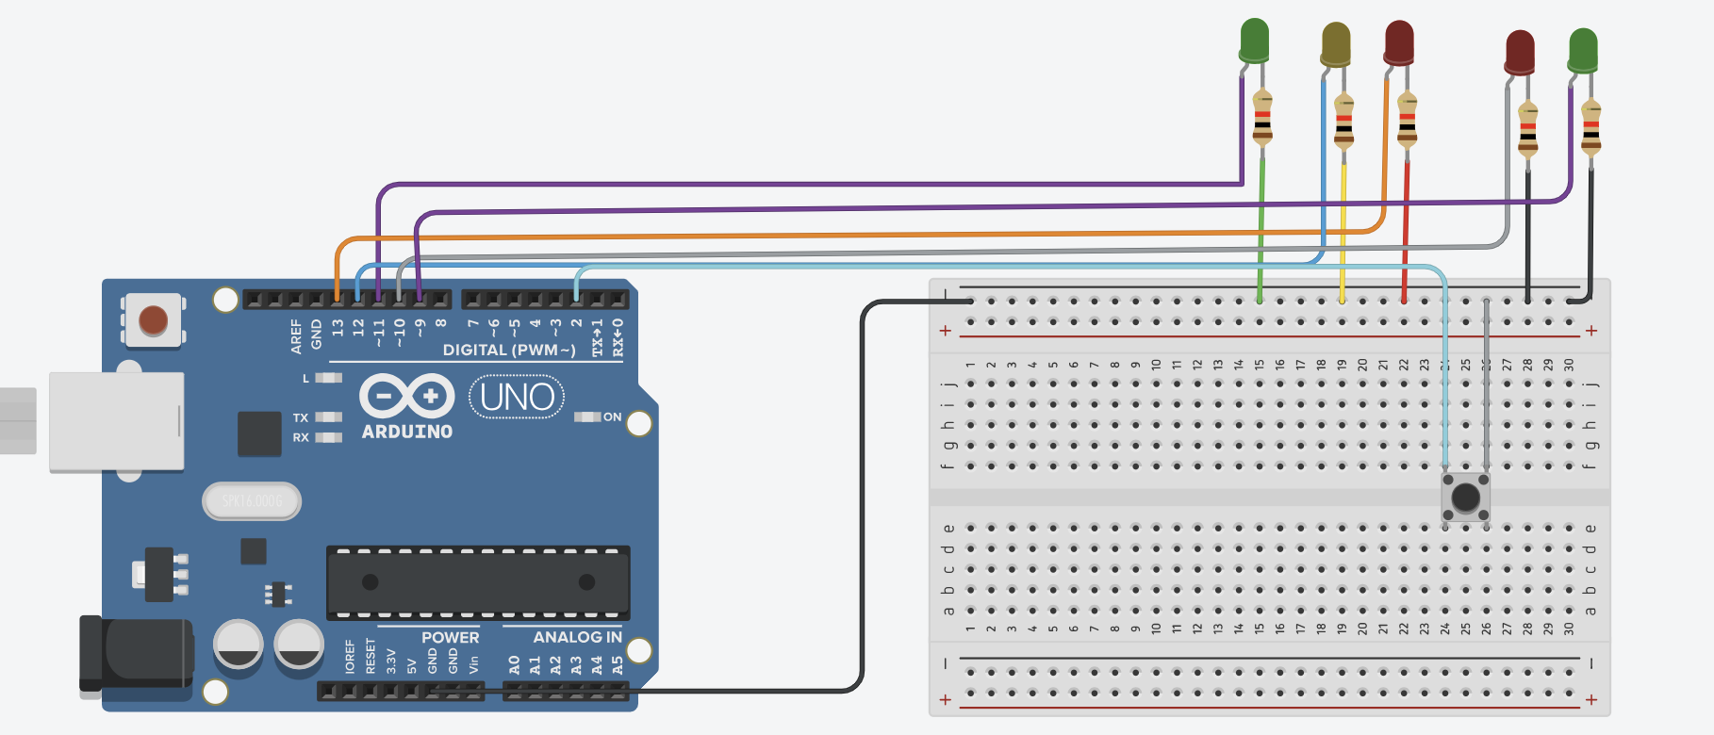
Tinkercad Simulation
06
TASKS 1 AND 2 · CIRCUIT DESIGN
Task 1 · Basic traffic light
Task 2 · Pedestrian crossing
Arduino Uno, breadboard, three LEDs and current-limiting resistors run the automatic four-state cycle.
Adds pedestrian red and green LEDs and a push button to simulate the six-state crossing.
Car Red | Car Yellow | Car Green | Pedestrian Red | Pedestrian Green | Push Button
Pin 13 | Pin 12 | Pin 11 | Pin 10 | Pin 9 | Pin 2
Hochschule Hamm-Lippstadt · Embedded Systems
06 / 10
Notes:
Both circuits were built and simulated in Tinkercad. Task 1 uses three LEDs with resistors on pins 13, 12 and 11. Task 2 keeps those and adds a pedestrian red LED on pin 10, a pedestrian green LED on pin 9 and a push button on pin 2. The simulation lets us test timing and the pedestrian request logic before touching real hardware.

Slide 7
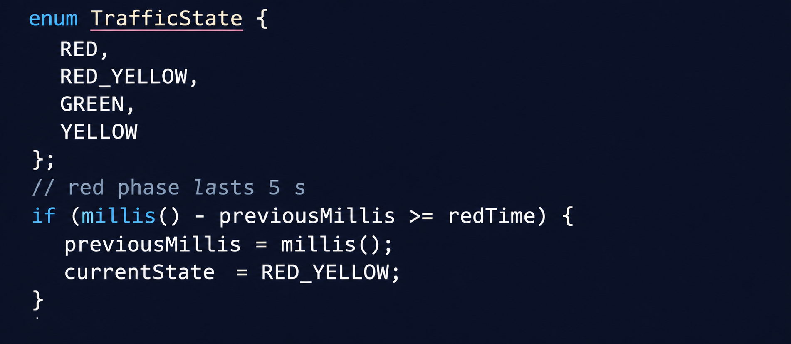
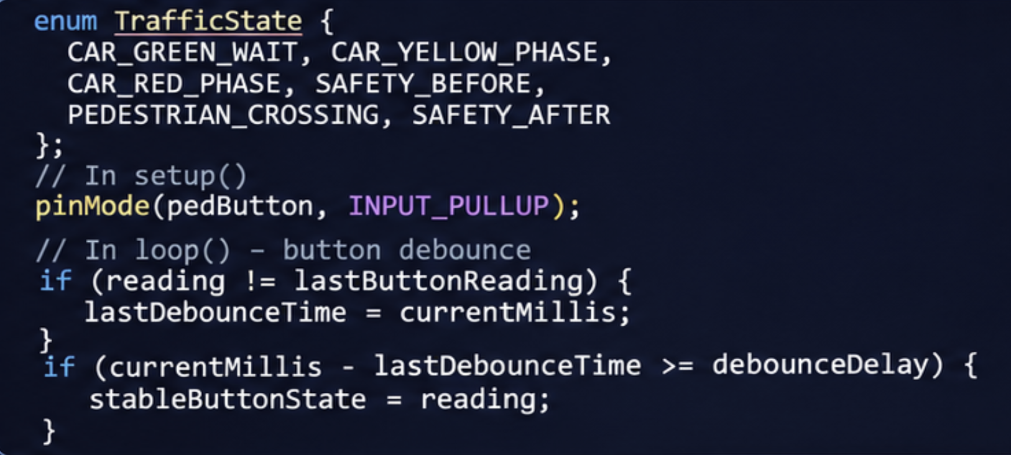
Arduino Programming
07
TASKS 3 AND 4 · IMPLEMENTATION
Task 3 · Four-state controller
Task 4 · Pedestrian crossing
RED 5 s → RED + YELLOW 1 s → GREEN 5 s → YELLOW 3 s
GREEN 10 s → YELLOW 3 s → RED 5 s → SAFETY 2 s → CROSSING 5 s → SAFETY 2 s
enum TrafficState {
RED, RED_YELLOW, GREEN, YELLOW
};
// red phase lasts 5 s
if (millis() - previousMillis >= redTime) {
previousMillis = millis();
};
}
LEDs on D13, D12 and D11
enum and switch-case for the four states
millis() timing, loop never blocked
Adds pedestrian LEDs D10, D9 and button D2
INPUT_PULLUP with 30 ms software debounce
Stored request and two 2 s safety phases
Cycle: 14 s
Cycle: 18 s · with request: 27 s
Hochschule Hamm-Lippstadt · Embedded Systems
07 / 10
Notes:
Task 3 implements the four-state light with an enum, a switch-case and millis() so the loop is never blocked; one cycle is 14 seconds. Task 4 extends it to six states, adds the pedestrian LEDs on pins 10 and 9 and the button on pin 2 with INPUT_PULLUP and a 30 ms software debounce, stores the request and adds two 2-second safety phases. Without a request the cycle is 18 seconds, with a request 27 seconds. The code shown is an excerpt, the full sketches are in the GitHub repository. From a basic four-state controller to a six-state pedestrian crossing system.

Slide 8
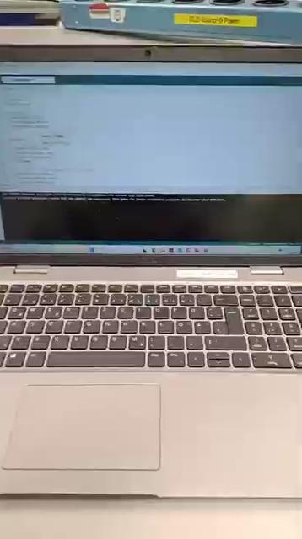
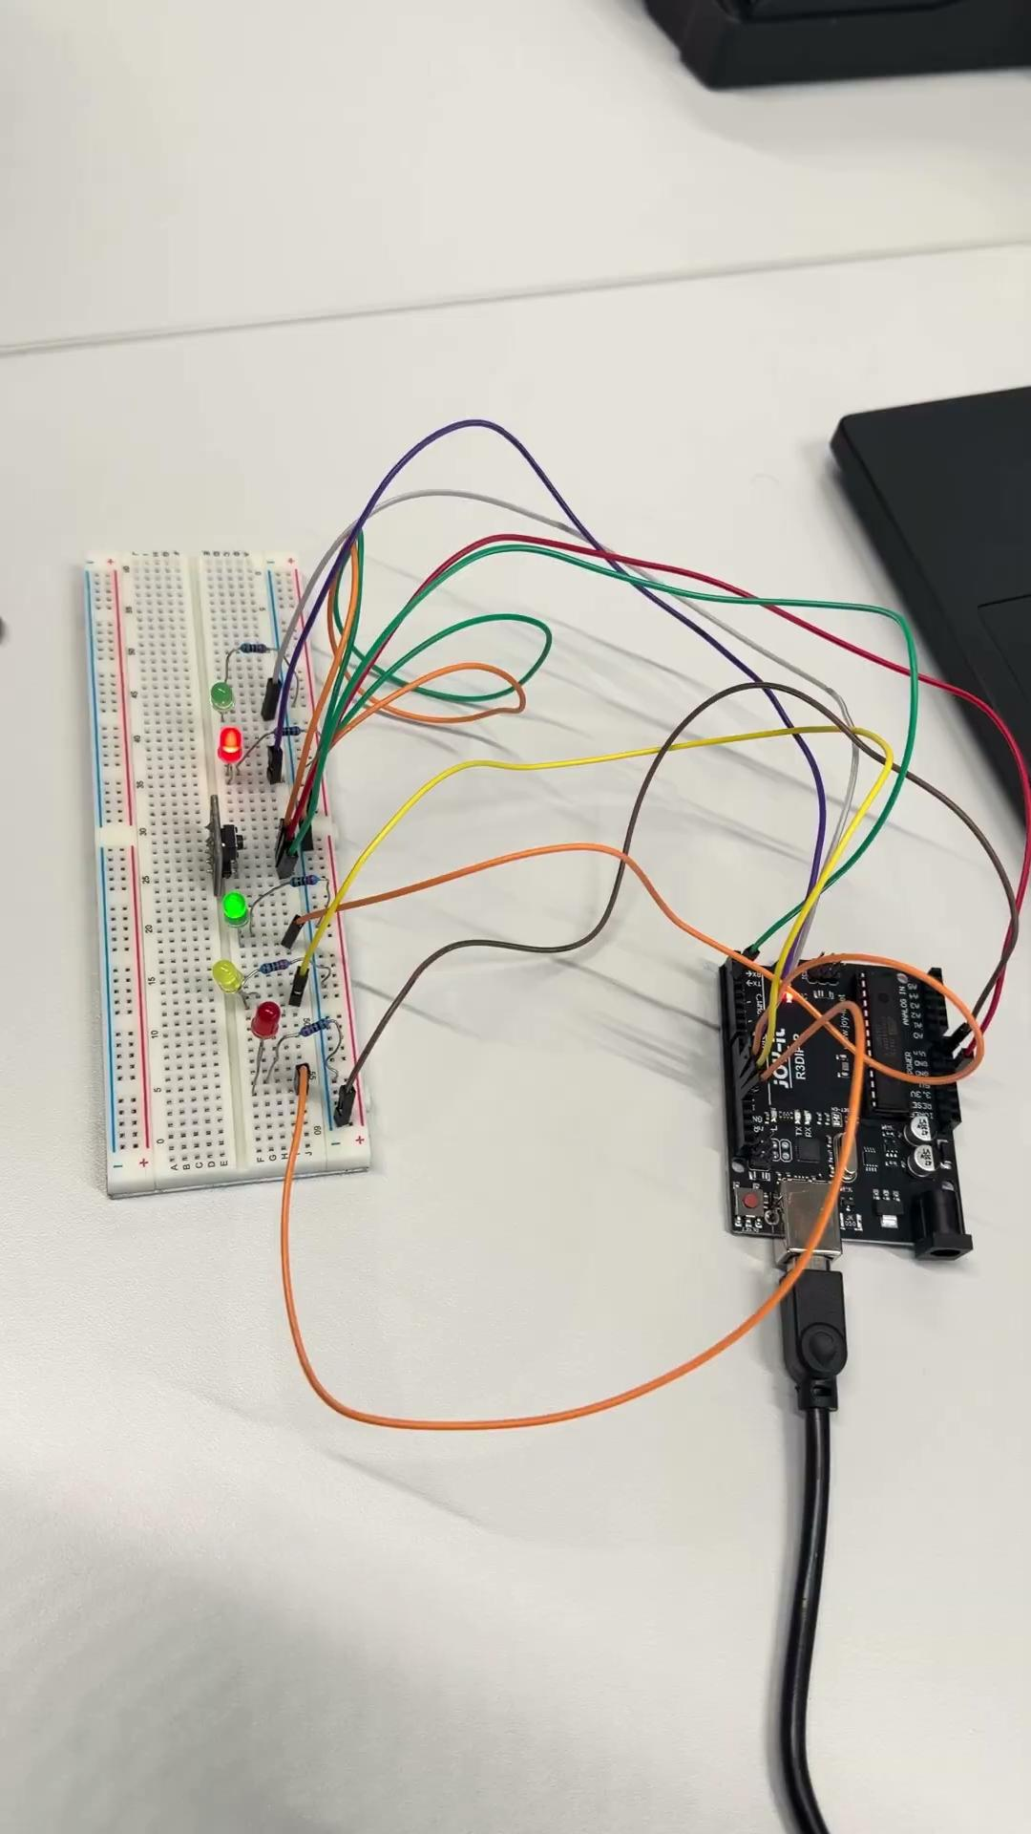
Hardware Demonstration
08
TASKS 3 AND 4 · REAL HARDWARE
Task 3 · Basic traffic light
Task 4 · Pedestrian crossing
Physical build on an Arduino Uno
Three LEDs on D13, D12 and D11
Automatic four-state cycle
Five LEDs and a push button on D2
Button-triggered crossing request
Six states with two safety phases
Objective: validate both controllers on real hardware, with correct state transitions, timing and pedestrian request handling.
Hochschule Hamm-Lippstadt · Embedded Systems
08 / 10
Notes:
Here we show the real hardware. Left is Task 3 with three LEDs running the automatic four-state cycle. Right is Task 4 with car and pedestrian LEDs plus the push button. Play the two demonstration videos here during the presentation. The images are still frames; the videos still need to be added.

Slide 9
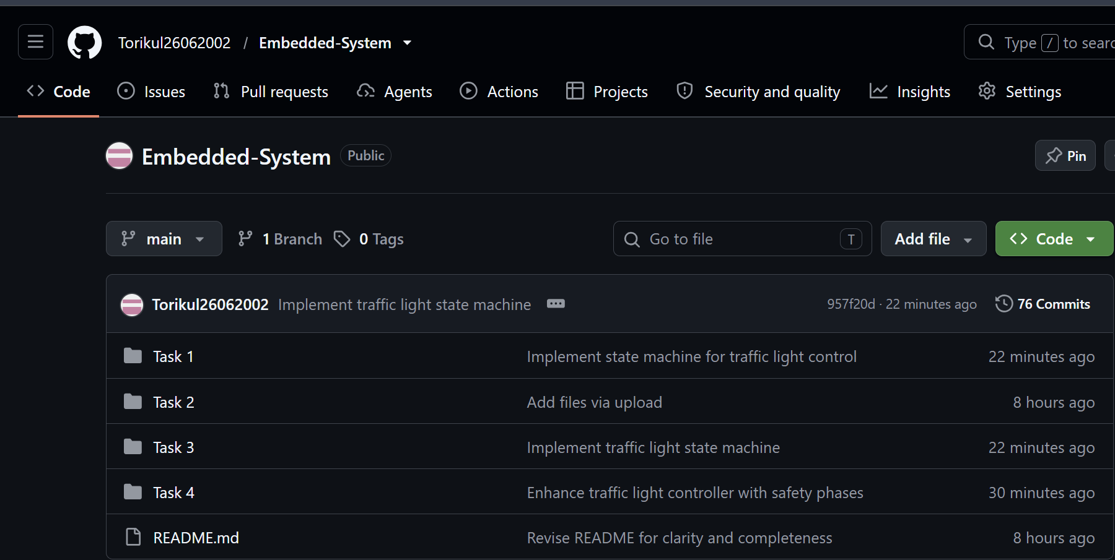

GitHub Repository
09
VERSION CONTROL · DOCUMENTATION
Repository structure
Task 1 – Basic traffic light, circuits, UML
Task 2 – Pedestrian crossing, state diagrams, code
Task 3 – Arduino implementation and demo video
Task 4 – Pedestrian controller code and demo link
README.md – Overview, hardware, tasks, outcomes
Arduino Uno, C/C++
UML diagrams
Tinkercad, Wokwi
Hardware demos
REPOSITORY
github.com/Torikul26062002/Embedded-System
Public · 76 commits
Hochschule Hamm-Lippstadt · Embedded Systems
09 / 10
Notes:
All code, diagrams and documentation are in one public GitHub repository, organised into four task folders plus a README. The 76 commits show the version history. Scan the QR code or use the link to open it.

Slide 10



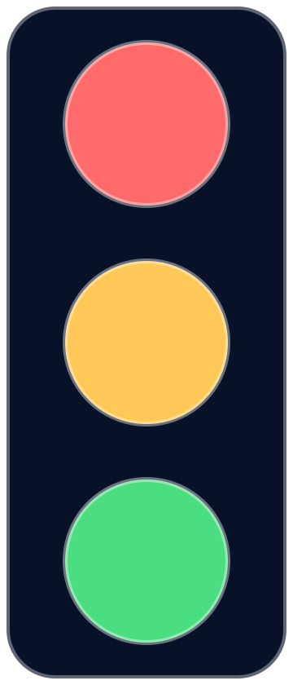
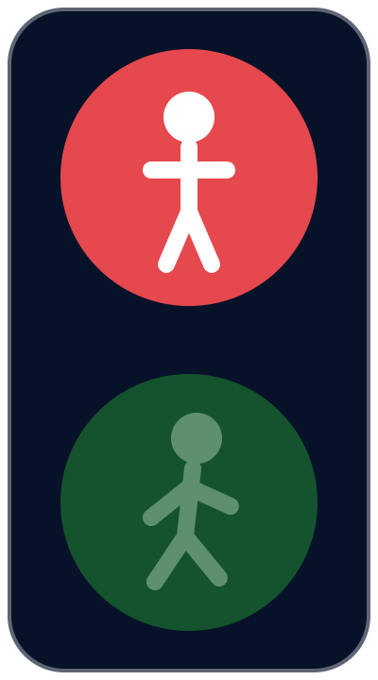
Thank You!
Do You Have Any Questions?
We appreciate your attention and look forward to your questions.
PRESENTED BY
Torikul Islam
Somya
Waleed Mushtaq
Hochschule Hamm-Lippstadt
Notes:
Thank you for your attention. We are happy to take questions on the state machines, the UML models, the circuits or the hardware demonstration.

